Slide 1

Chapter 6 Security and Reliability of Distributed Software and Systems
Lecture 23
Forms-Based Security
Text Chapter 6.2
Yinong Chen

Slide 2
Roadmap of Chapter 6
General Security & Reliability Concepts (Text Section 6.1)
IIS Roles and Windows-Based Security Mechanism
Case Study: Windows-Based Security Deployment
Forms-Based Security Creating an independent security system for Web access control and resource authorization (Text Section 6.2)
Secure Socket Layer for Secure HTTP Connection
Reliability and Security in Windows Communication Foundation
Data Encryption and Decryption

Slide 3
Windows-Based Security Deployment and Testing (Contd. from last lecture)
Create a directory named Basic somewhere — anywhere — on your computer, e.g., C drive.
Use the IIS configuration manager to create a virtual directory named “Basic” and link it. How? See next page.
While in the IIS configuration manager, configure Basic to require basic authentication and to disallow anonymous access. How?
Right-click Basic in the IIS configuration manager and select Properties from the ensuing context menu.
Go to the Directory Security page of the property sheet that pops up and click the Edit button under “Anonymous access and authentication control.”
In the ensuing dialog box, uncheck “Anonymous access” and check “Basic authentication”.
Right click the folder to convert the folder into application
OK the changes, and then close the configuration manager

Slide 4
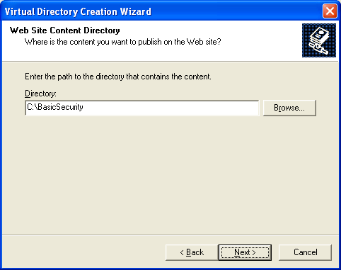
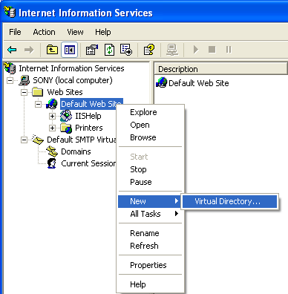
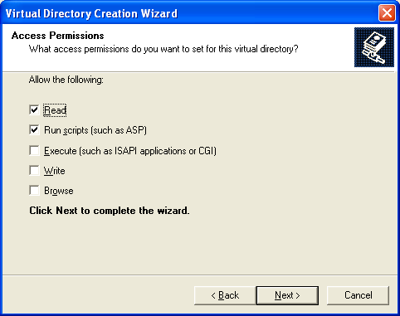
Creating a Virtual Directory in IIS
Browse to
Right click

Slide 5
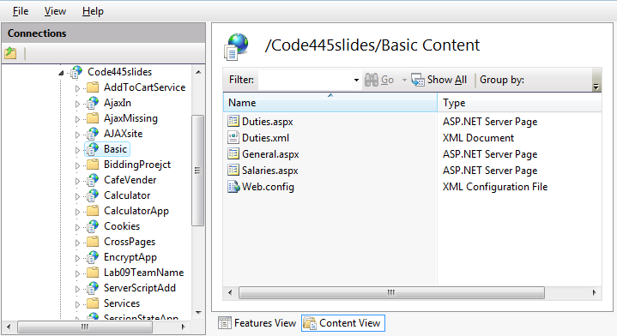
A directory BasicSecurity is created in IIS

Slide 6
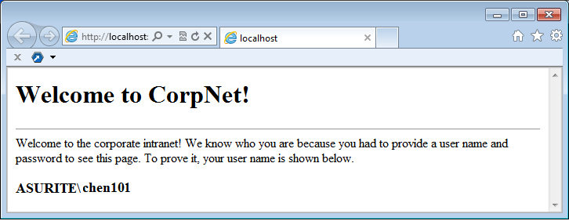
Creating the Authentication (contd.)
Create user accounts on your Windows for testing purposes, e.g., “Bob”, “Jeff”, “Julia”, …
Change the permissions on Salaries.aspx by removing the Anonymous access. See next page
Type http://localhost/Basic/General.aspx into your browser’s address bar to call up General.aspx. You will see the page, because, by default, it allows anonymous access.
http://venus.eas.asu.edu/wsrepository/BasicSecurity/General.aspx
if (User.Identity.IsAuthenticated)
Response.Write (User.Identity.Name);

Slide 7
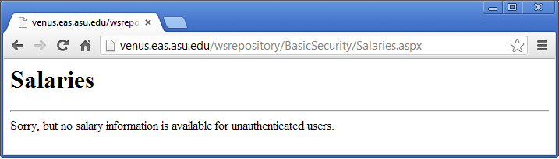
Creating the Authentication (contd.)
7. Type http://localhost/Basic/Salaries.aspx into your browser’s address bar. A dialog box will pop up, because the Salaries.aspx requires callers to be authenticated using basic authentication. Enter Bob’s user name and password.
Version deployed to ASU Repository
http://venus.eas.asu.edu/wsrepository/BasicSecurity/Salaries.aspx

Slide 8
Access Salaries.aspx before changing permission
The page is accessible, but the code in the page prevents user from seeing the confidential information:
if (!User.Identity.IsAuthenticated)
Response.Write ("Sorry, but no salary information " +
"is available for unauthenticated users.");
else { …

Slide 9
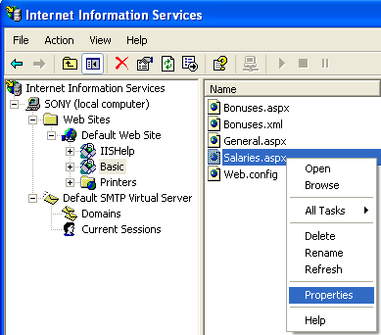
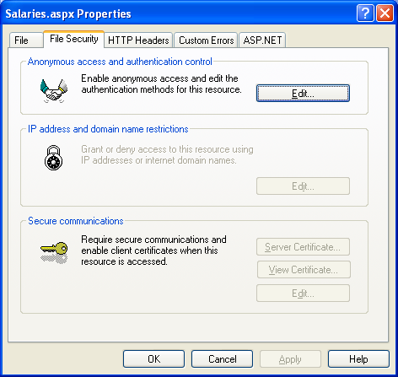
Change the Permission to Basic Security
Right click

Slide 10
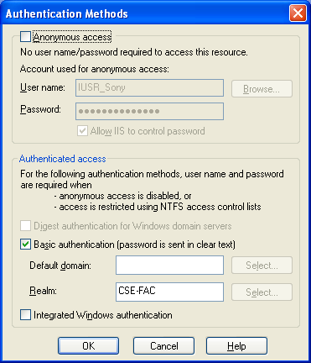
Remove Anonymous access

Slide 11
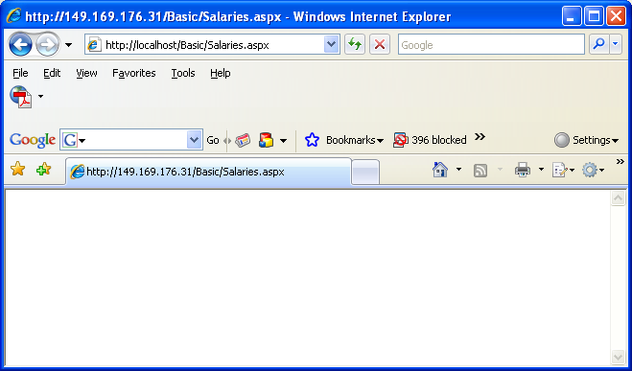
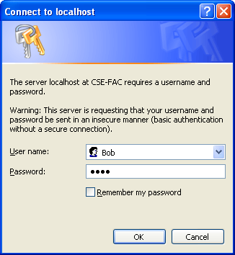

Authenticated Access
Type your windows login name and password

Slide 12
Roadmap of Chapter 6
General Security & Reliability Concepts (Text Section 6.1)
IIS Roles and Windows-Based Security Mechanism
Forms-Based Security Creating an independent security system for Web access control and resource authorization (Text Section 6.2)
Secure Socket Layer for Secure HTTP Connection
Reliability and Security in Windows Communication Foundation
Data Encryption and Decryption

Slide 13
Security Check
Client Browser
IIS
IP address and domain permitted?
No
Yes
“None”
Check Web.config
token
token
“Forms”
“Windows”
ASP .Net
No
No
Windows authentication successful?
Forms authentication successful?
Yes
Windows Sever
True
False
Impersonation enabled
?
No
Other resource allowed?
Use impersonated account
Use configuration account
none
Yes
Access Allowed
Access Denied

Slide 14
Entry Point Control in Web.config File
Can be Forms, Windows, or None
<configuration>
<system.web>
<authentication mode=“Forms" />
<identity impersonate=“false"/>
</system.web>
</configuration>
Make sure that the same credential coming from the IIS is applied
The identity element’s attribute impersonate is used for control the access to the resources (files) on the server’s hard drive.

Slide 15
Impersonation Disabled
<identity impersonate = “…”> attribute not defined (not given): The default will be applied:
The application will inherit the identity of the worker process (aspnet_wp.exe), which runs using an account (defined in machine.config) with weaker privileges than the local system account;
By doing so, an intruder will not have the administrative access even if security is breached (have the administrator’s password). This is because the Local System account has access to almost all resources on the local computer not specifically denied to it;
The strongest security option – It may be too strong though:
This option may deny a user to access a disk file, e.g., an XML file. In this case, you need to define the attribute (next page).

Slide 16
Impersonation Enabled
<identity impersonate = "true" userName="domain\user" password="password" />
ASP.NET impersonates the token generated using this identity specified in the Web.config file given in the identity element. This feature is useful for developers to test the program using a different account.
<identity impersonate = "false" > ASP.NET impersonates the token passed to it by IIS, which is either an authenticated user or the anonymous Internet user account. This is the common use.

Slide 17

Forms Security
Forms security is a common way of implementing access control.
Simply ask a user to type credentials (typically a user name and a password) into a Web form.
The credentials can be issued
by the administrator, e.g., using a password generator
through self-registration. Image validation required
The credentials can be saved in different places and in different forms
Browser and cookies
Web.config, in clear text or encrypted
XML or text file
Database

Slide 18
Forms Security
ASP.NET can save the credentials in the Web browser (temporal) or in cookies (persistent).
When a user attempts to access a protected resource at the first time, ASP.NET automatically redirects the user to the login page.
If the login is successful, ASP.NET then issues the user an authentication ticket in the form of a cookie, and automatically redirects the user back to the page originally requested.
The ticket allows that user to revisit protected portions of the site without having to login again and again. One can control the ticket’s lifetime and decide how long the login is good for.
Both authentication and authorization can be defined.
→ Learn by examples

Slide 19
Files of Forms Authentication/Authorization
The application’s user interface consists of two content pages:
Default.aspx, which can be viewed by anyone
Staff.aspx, which is available only to authenticated users. “Authenticated users”
The management pages consist of
Login.aspx, which asks for a user name and a password.
The valid user names and passwords stored in a Web.config in a virtual root directory
Another Web.config in the sub directory
And more…

Slide 20
Application Architectures
http://venus.eas.asu.edu/WSRepository/FormsSecurity/
FormsSecurity
Default
.aspx
Default
.aspx
Web
.Config
For Authentication
Login
.aspx
Web
.Config
Login
.aspx
Protected
For Authorization
Staff
.aspx
Web
.Config
Staff
.aspx
Web
.Config
Physical Organization
Logical Organization

Slide 21
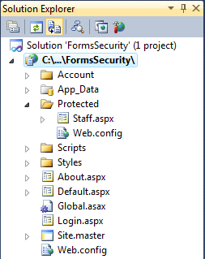
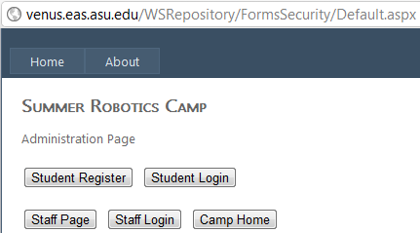
Default.aspx
protected void btnStaff_Click(object sender, EventArgs e)
{
Response.Redirect("Protected/Staff.aspx");
}
}
Transparently redirected to the Login.aspx, whose URL is stored in Web.config, then return to this page

Slide 22
<authentication> Element in Web.config
<authentication mode="Windows|Forms|Passport|None"> <forms name="name"
loginUrl="url_of_Login.aspx"
protection="All|None|Encryption|Validation“
timeout="30" path="/" >
requireSSL="true|false"
slidingExpiration="true|false">
<credentials passwordFormat="Clear|SHA1|MD5">
<user name="username" password="password"/>
</credentials>
</forms>
</authentication>

Slide 23
Cryptographic Algorithms
SHA-1 (Secure Hash Algorithm, 0, 1, 2) is a cryptographic hash function designed by the National Security Agency and published by the NIST as a U.S. Federal Information Processing Standard.
MD5 (Message-Digest algorithm 5) is a widely used cryptographic hash function with a 128-bit (16-byte) hash value.
There are many other cryptographic algorithms:
Asymmetric-key
Barrett reduction
DES (Data Encryption Standard) is an algorithm we will discuss later.

Slide 24
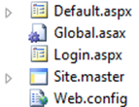
Web.config in the Application Root Directory
<configuration>
<system.web>
<authentication mode="Forms">
<forms name = "LoginForm" loginUrl="Login.aspx" timeout="30" >
<credentials passwordFormat="Clear">
<user name="Julia" password="abc" />
<user name="John" password="45678" />
<user name="Bob" password="123" />
<user name="Alice" password="12345" />
</credentials>
</forms>
</authentication>
</system.web>
</configuration>
Entry address stored here
Even though, one cannot use “View Source” to read the file

Slide 25

Web.config in the “Protected” Sub Directory
<configuration>
<system.web>
<authorization>
<deny users="?" />
</authorization>
</system.web>
</configuration>
?: Deny unauthenticated users

Slide 26
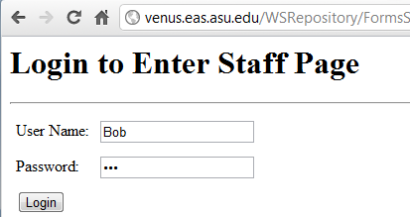
Login.aspx
<html>
<body>
<h1> Login to access Staff page
</h1> <hr>
<form runat="server">
<table cellpadding=“4">
<tr>
<td> User Name: </td>
<td>
<asp:TextBox ID= "txtUserName" RunAt="server" />
</td>
</tr>
<tr><td> Password: </td><td>
<asp:TextBox ID=“txtPassword" TextMode="password"
RunAt="server" />
</td>
</tr>
<tr>
<td>
<asp:Button Text= "btnLogin" OnClick="LoginFunc" RunAt="server" />
</td>
</tr>
</table>
</form>
<hr>
<h3><asp:Label ID="Output" RunAt="server"/> </h3>
</body>
</html>
<script language="C#" runat="server">
void LoginFunc(Object sender, EventArgs e)
{
if (FormsAuthentication.Authenticate (txtUserName.Text, txtPassword.Text))
FormsAuthentication.RedirectFromLogin (UserName.Text, false);
else
Output.Text = "Invalid login";
}
</script>
Save credential?
Look up the Web.config
Persistent option not checked.

Slide 27
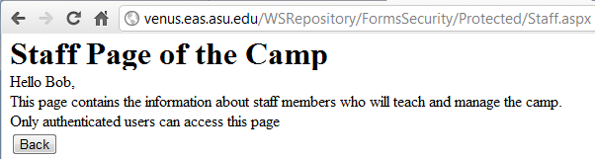
Staff.aspx in the Protected Sub Directory
<html xmlns="http://www.w3.org/1999/xhtml">
<head runat="server"> <title>staff page</title> </head>
<body>
<form id="form1" runat="server">
<h1>Staff Page of the Camp</h1>
<div>
<% Response.Write("Hello " + Context.User.Identity.Name + ", "); %> <br />
This page contains the information about staff members who will teach
and manage the camp. Only authenticated users can access this page .<br />
</div>
</form>
</body>
</html>

Slide 28
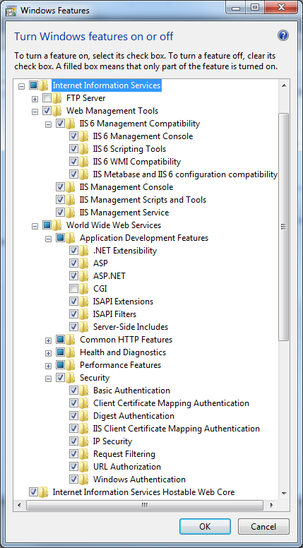
Deployment
You can use
.Net development server
Your Windows IIS
WebStrar (Final Deployment)
V-Lab
If you use your own IIS or V-Lab, you need to turn on your IIS: Control Panel → Programs → Programs and Features → Turn Windows Features on or off

Slide 29
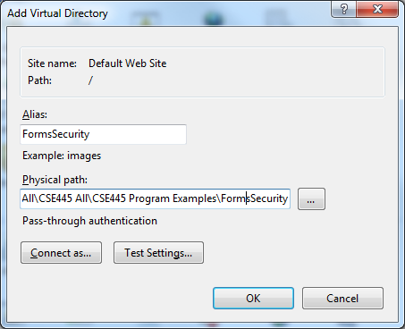
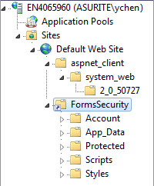
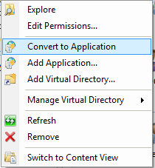
Create Virtual Directory and Convert to Application
Administrative Tools → IIS Manager
Create a virtual directory and link your project folder to the virtual directory
Convert to Application
Right click

Slide 30
Testing in Action: Steps 1 and 2
Start the application
Click on “Staff” button

Slide 31
Steps 3 and 5 in Action
Staff page uses Response.Redirect to go to Protected/Staff.aspx. But because Staff.aspx is viewable only by authenticated users, ASP.NET displays the login form in Login.aspx.
4. Type “Bob’ into the user name field and “123” into the password field.

Slide 32
Step 5 in Action
Staff.aspx appears. Because you are now an authenticated user, you have been issued an authentication ticket that accompanies subsequent requests as a cookie.

Slide 33
Configure the Authorization using the Web.config in the Protected Sub Directory
* all
<configuration>
<system.web>
<authorization>
<deny users="?" />
</authorization>
</system.web>
</configuration>
<allow users= "*" />
<allow users = “Alice" />
<deny users = "*" />
<deny users "*" />
<allow users = “Alice" />
? unauthenticated

Slide 34
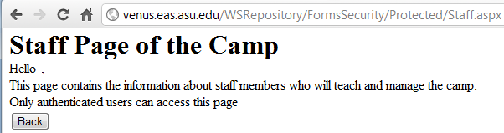
Apply <allow users="*" />
<configuration> <system.web>
<authorization>
<allow users="*" />
</authorization>
</system.web> </configuration>
You will enter the protected page without being identified, and thus, your name cannot be printed.

Slide 35
Different Pages with Different Authorizations
How Do You Create Different Pages with Different Authorizations?
FormsSecurity
Default
.aspx
Web
.Config
Login
.aspx
Web.config Authorization2
Web.config Authorization1
Staff
Student
Staff.aspx
Web
.Config
Student
.aspx
Web
.Config

Slide 36
Example: Applying for a Bank Account
Apply for Access
Check Credential
Issue an ID / User Name
Use ID to Create Account
Apply for Access
Name
Check credit score and other criteria
SSN
Approval?
Send reject mail
Address
Birth Date
Create account
Open and modify Web.config
Authorization Section
User ID
Issue User ID
SSN
Password
Match?
Strong?
Retype Password

Slide 37
Problems of using Web.config for Authentication
Users IDs and password are buried in many other data;
Authentication is slow (sequential comparison) and unmanageable if the number of users is large;
Authorization is unmanageable if accessibility needs to be changed from time to time.
One could write an editor to manage the authentication and authorization, which requires development work.

Slide 38
Files of Forms Authentication Using Database
The application’s interface consists of two pages:
Default.aspx can be viewed by anyone
Staff.aspx is available only to authenticated users.
The management pages consist of
Login.aspx, which asks for a user name and a password.
Web.config in the virtual root directory
The valid user names and passwords stored in a Web.config in a secret sub directory

Slide 39
Login.aspx: Part 1 HTML
<html>
<body>
<h1>Please Log In</h1> <hr>
<form runat="server">
<table cellpadding="8">
<tr> <td>User Name:</td>
<td> <asp:TextBox ID="UserName" RunAt="server" /></td> </tr>
<tr> <td> Password: </td>
<td><asp:TextBox ID="Password" TextMode="password"
RunAt="server" /> </td> </tr>
<tr>
<td><asp:Button Text="Log In" OnClick="LoginFunc"
RunAt="server" /></td>
<td><asp:CheckBox Text="Keep me signed in" ID="Persistent"
RunAt="server"/> </td>
</tr>
</table>
</form>
<hr> <h3><asp:Label ID="Output" RunAt="server" /></h3>
</body>
</html>
continued

Slide 40
Login.aspx: Part 2 C#
<script language="C#" runat="server">
void LoginFunc (Object sender, EventArgs e)
{
if (myAuthenticate (UserName.Text, Password.Text))
FormsAuthentication.RedirectFromLogin (UserName.Text, Persistent.Checked);
else
Output.Text = "Invalid login";
}
if (FormsAuthentication.Authenticate (UserName.Text, Password.Text))
continued

Slide 41
Login.aspx: Part 3, Accessing DB
bool myAuthenticate (string username, string password) {
SqlConnection connection = new SqlConnection ("server=localhost;database=weblogin;uid=sa;pwd=letme");
try {
connection.Open ();
StringBuilder builder = new StringBuilder ();
builder.Append ("select count (*) from users " + "where username = \' ");
builder.Append (username);
builder.Append ("\' and cast (rtrim (password) as " + "varbinary) = cast (\' ");
builder.Append (password);
builder.Append ("\' as varbinary)");
SqlCommand command = new SqlCommand (builder.ToString (), connection);
int count = (int) command.ExecuteScalar ();
return (count > 0);
}
catch (SqlException) { return false; }
finally { connection.Close (); }
}
</script>
If count > 0, an entry is found!
We can make password more secure by not allowing “read” the database.

Slide 42
Login.aspx: Part 3, Using an XML File
bool myAuthenticate (string username, string password) {
string fLocation = Path.Combine(Request.PhysicalApplicationPath, @"App_Data\Users.xml");
if (File.Exists(fLocation))
{
FileStream FS= new FileStream(fLocation, FileMode.Open);
XmlDocument xd = new XmlDocument();
xd.Load(FS);
XmlNode node = xd;
XmlNodeList children = node.ChildNodes;
foreach (XmlNode child in children)
{
// check if the username and password exist in the XML file;
}
}
}

Slide 43
Signing out
It is always a good practice to provide the users a signing out button, for two reasons:
More secure
Resources can be recycled immediately
Void Signout(object sender, EventArgs e)
{
FormsAuthentication.SignOut();
Server.Transfer(“Default.aspx”);
}

